Slide 1
(CSC 102)
Discrete Structures
Lecture 10

Slide 2
Previous Lectures Summary
Divisors
Prime Numbers
Fundamental Theorem of Arithmetic
Division Algorithm .
Greatest common divisors.
Least Common Multiple
Relative Prime

Slide 3
Elementary Number Theory II

Slide 4
Today's Lecture
Rational Number
Properties of Rational Numbers
Irrational numbers
Absolute values
Triangular inequality
Floor and Ceiling functions

Slide 5
Rational Numbers
A real number r is rational if, and only if, r = a/b for some integers a and b with b ≠ 0. A real number that is not rational is irrational.
More formally, r is a rational number ↔ ∃ integers a and b such that r = a/b, b ≠ 0.
Determine whether following numbers are rational?
10/3
-(5/39)
2/0
0.121212121212………

Slide 6
Cont….
Yes, 10/3 is quotient of the integers 10 and 3.
Yes, -5/39, which is a quotient of the integers.
No, 2/0 is not a number (division by 0 is not allowed)
Yes,
Let x=0.1212121212121, then 100x=12.12121212….
100x – x = 12.12121212….. - 0.1212121212…… = 12.
99∙x = 12 and so x=12/99.
Therefore 0.12121212….. = 12/99, which is a ratio of two non zero integers and thus is a rational number.

Slide 7
Properties Of Rational Number
Theorem: Every Integer is a rational Number
Proof: Its obvious by the definition of rational Number.

Slide 8
Properties Of Rational Number
Theorem: The sum of any two rational Numbers is rational.
Proof: Suppose r and s are rational numbers. Then by definition of rational,
r = a/b and s = c/d
for some integers a, b, c, and d with b ≠ 0 and d ≠ 0. So r + s = a/b + c/d
= (ad + bc)/b∙d.
Let p = ad + bc and q = bd. Then p and q are integers because product and sum of integers are integers. Also q ≠ 0.
Thus r+s = p/q. so r+s is a rational number.

Slide 9
Properties Of Rational Number
Theorem: The double of a rational number is rational.
Proof: Suppose r is rational number. Then 2r = r + r is a sum of two rational number and is a rational number.

Slide 10
Irrational Numbers
The number which is not rational is called irrational number. i.e., a decimal representation which is neither repeating and non recurring. For example
=1.41421356237309……
Note: Product of two irrational is not irrational.

Slide 11
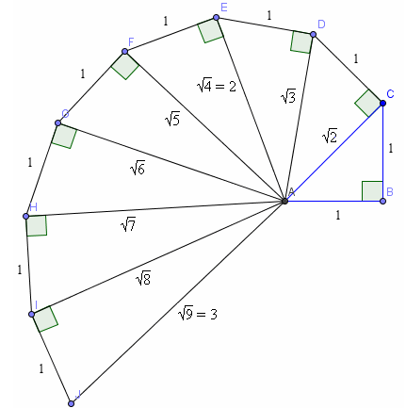
Cont….
Visualizing some irrational numbers .

Slide 12
Absolute Number
For any real number x, the absolute value of x, denoted |x|, is defined as follows:
Examples
|5|= 5, |-4/7|= -(-4/7)=4/7, |0|=0

Slide 13
Absolute Number
Lemma: For all real numbers r, −| r | ≤ r ≤ | r |.
Proof: Suppose r is any real number. We divide into cases according to whether r ≥ 0 or r < 0.
Case 1: (r ≥ 0): In this case, by definition of absolute value, |r| = r . Also, since r is positive and −|r | is negative, −|r | < r . Thus it is true that −|r| ≤ r ≤ |r |.
Case 2: (r<0): both sides by −1 gives that −|r| = r . Also, since r is negative and |r | is positive ,r < |r |. Thus it is also true in this case that −|r| ≤ r ≤ |r |. Hence, in either case,
−|r| ≤ r ≤ |r |

Slide 14
Cont…..
Theorem:
Proof:

Slide 15
Triangular Inequality
Theorem: For all real numbers x and y,
|x + y| ≤ |x| + |y|.
Proof: Suppose x and y, are any real numbers.
Case 1: (x + y ≥ 0):
In this case, |x + y| = x + y, x ≤ |x| and y ≤ |y|.
Hence, |x + y| = x + y ≤ |x| + |y|.
Case 2 (x + y<0):
In this case, |x + y| = −(x + y)
and also, −x ≤ |−x| = |x| and −y ≤ |− y| = |y|.
It follows, that
|x + y| = (−x) + (−y) ≤ |x| + |y|.
Hence in both cases |x + y| ≤ |x| + |y|

Slide 16
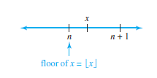
Floor and Ceiling
Given any real number x, the floor of x, denoted , is defined as follows:
= that unique integer n such that n ≤ x < n + 1.
Symbolically, if x is a real number and n is an integer, then
= n ⇔ n ≤ x < n + 1.

Slide 17
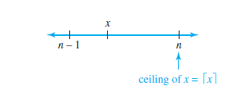
Ceiling
Given any real number x, the ceiling of x, denoted , is defined as follows:
= that unique integer n such that n − 1 < x ≤ n.
Symbolically, if x is a real number and n is an integer, then
= n ⇔ n − 1 < x ≤ n.

Slide 18
Examples
Compute and for each of the following values of x:
25/4
0.999
−2.01
Solution:
25/4 = 6.25 and 6 < 6.25 < 7; hence
b. 0 < 0.999 < 1; hence .
c. −3 < −2.01 < −2; hence

Slide 19
Example
The 1,370 students at a college are given the opportunity to take buses to an out-of-town game. Each bus holds a maximum of 40 passengers.
For reasons of economy, the athletic director will send only full buses. What is the maximum number of buses the athletic director will send?
b. If the athletic director is willing to send one partially filled bus, how many buses will be needed to allow all the students to take the trip?

Slide 20
General Values of Floor
Solution:

Slide 21
Cont…
Is the following statement true or false? For all real
Numbers x and y,
Solution: The statement is false, take x = y = 1/2, then
Hence

Slide 22
Properties of Floor
Theorem: For all numbers x and all integers m,
Proof: Suppose a real number x and an integer m are given. Let n = that unique integer n such that, n ≤ x < n + 1. Add m to all sides to obtain n + m ≤ x + m < n + m + 1. Now n + m is an integer and so, by definition of floor,
But n = . Hence by substitution

Slide 23
Cont….
Theorem:
Proof: Suppose n is a integer. Then either n is odd or n is even.
Case 1: in this case n = 2k+1 for some integers k.

Slide 24
Cont…
also. Since both the left-hand and right-hand sides equal k, they are equal to each other. That is,
Case 2: In this case, n = 2k for some integer k.
Since k=n/2 by the definition of even number. So

Slide 25
Lecture Summary
Rational Number
Properties of Rational Numbers
Irrational numbers
Absolute values
Triangular inequality
Floor and Ceiling

